Slide 1
Order & Growth Rate Of Algorithm
Presented by : Muhammad Atif

Slide 2
Topics of presentation
What is growth rate of an algorithm ?
What is the order of an algorithm ?
What is recurrence relation & substitution method ?

Slide 3
What is Growth rate of Algorithm ?
The growth rate of an algorithm mean how the resources (time or space) of an algorithm increases as the size of the input to the algorithm increases.
It is mostly expressed by using big O notation, which provides an upper bound on the growth rate of the algorithm.
Understanding the growth rate of an algorithm is crucial for analyzing the efficiency and scalability of algorithm which help us to choose the right algorithm for our selective problem.

Slide 4
What is Order of an Algorithm ?
The order of an algorithm, also known as the "time complexity" or "big O notation," helps us understand how the algorithm's performance scales as the input size increases.
It provides an upper bound on the worst-case scenario for the algorithm's performance.
The order give the high level understanding of algorithm by ignoring the coefficient and other constant factors while growth rate give you the detailed insight of an algorithm

Slide 5
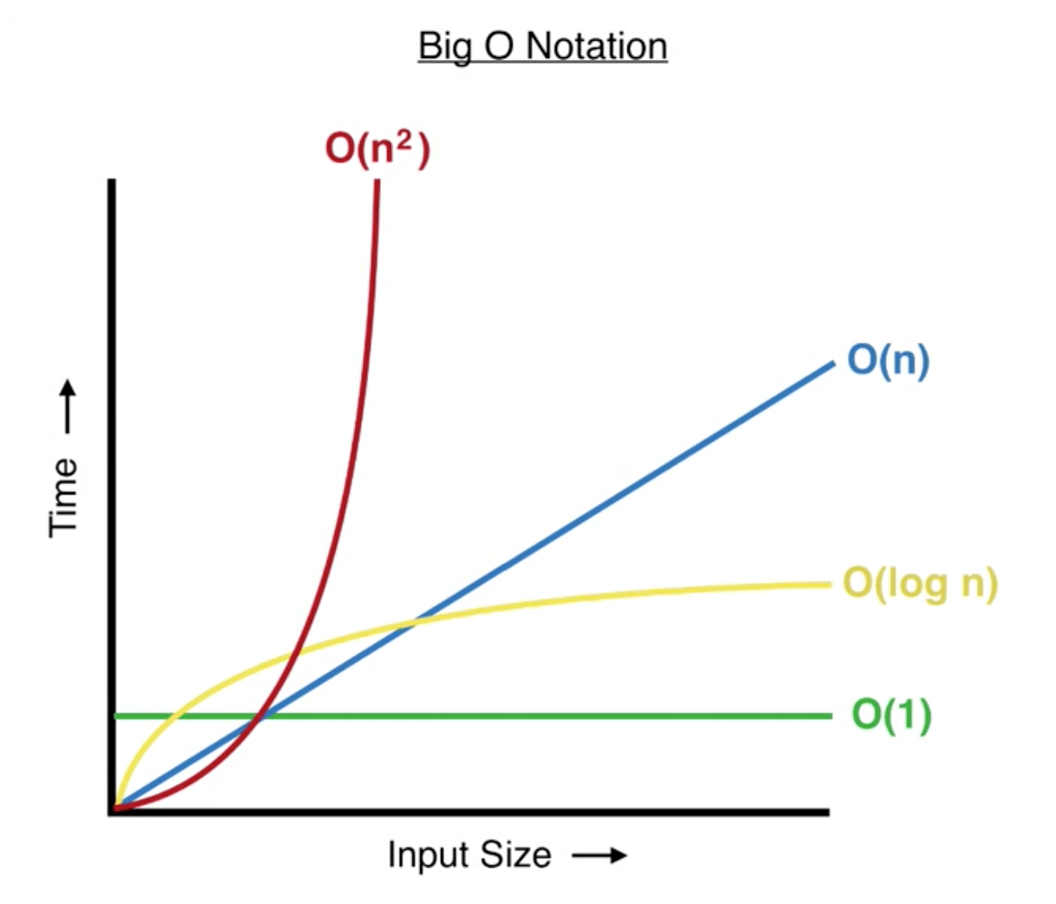
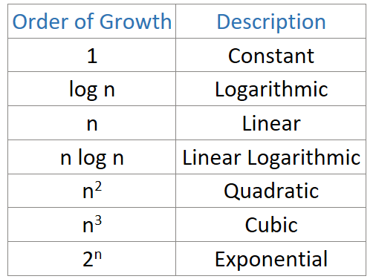

Slide 6
Recurrence Relation:
It's a rule that helps find the value of a sequence based on previous values.
Example: factorial where { n! = n x (n-1)! }
Substitution Method:
A technique to solve recurrence relations.
Guess a solution, prove it by substitution, solve for constants, and verify.
Helps find formulas describing sequences in a systematic way.
(recurrence relations define sequences, and the substitution
method helps us find formulas to describe them efficiently.)

Slide 7
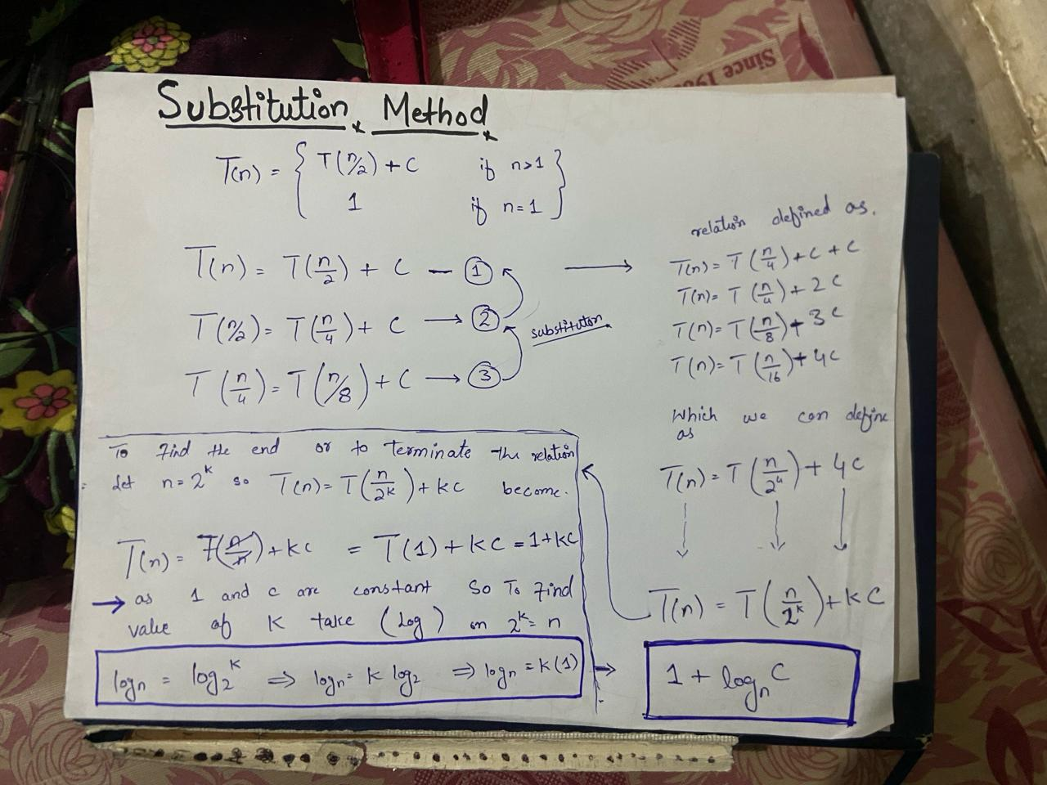

Slide 8
Why we are using the (log) function to find the value of k ?
we use the logarithmic function to find the value of “k” because this relation involves dividing the problem size by 2 at each step, leading to a logarithmic time complexity

Slide 9
THE END

